Slide 1
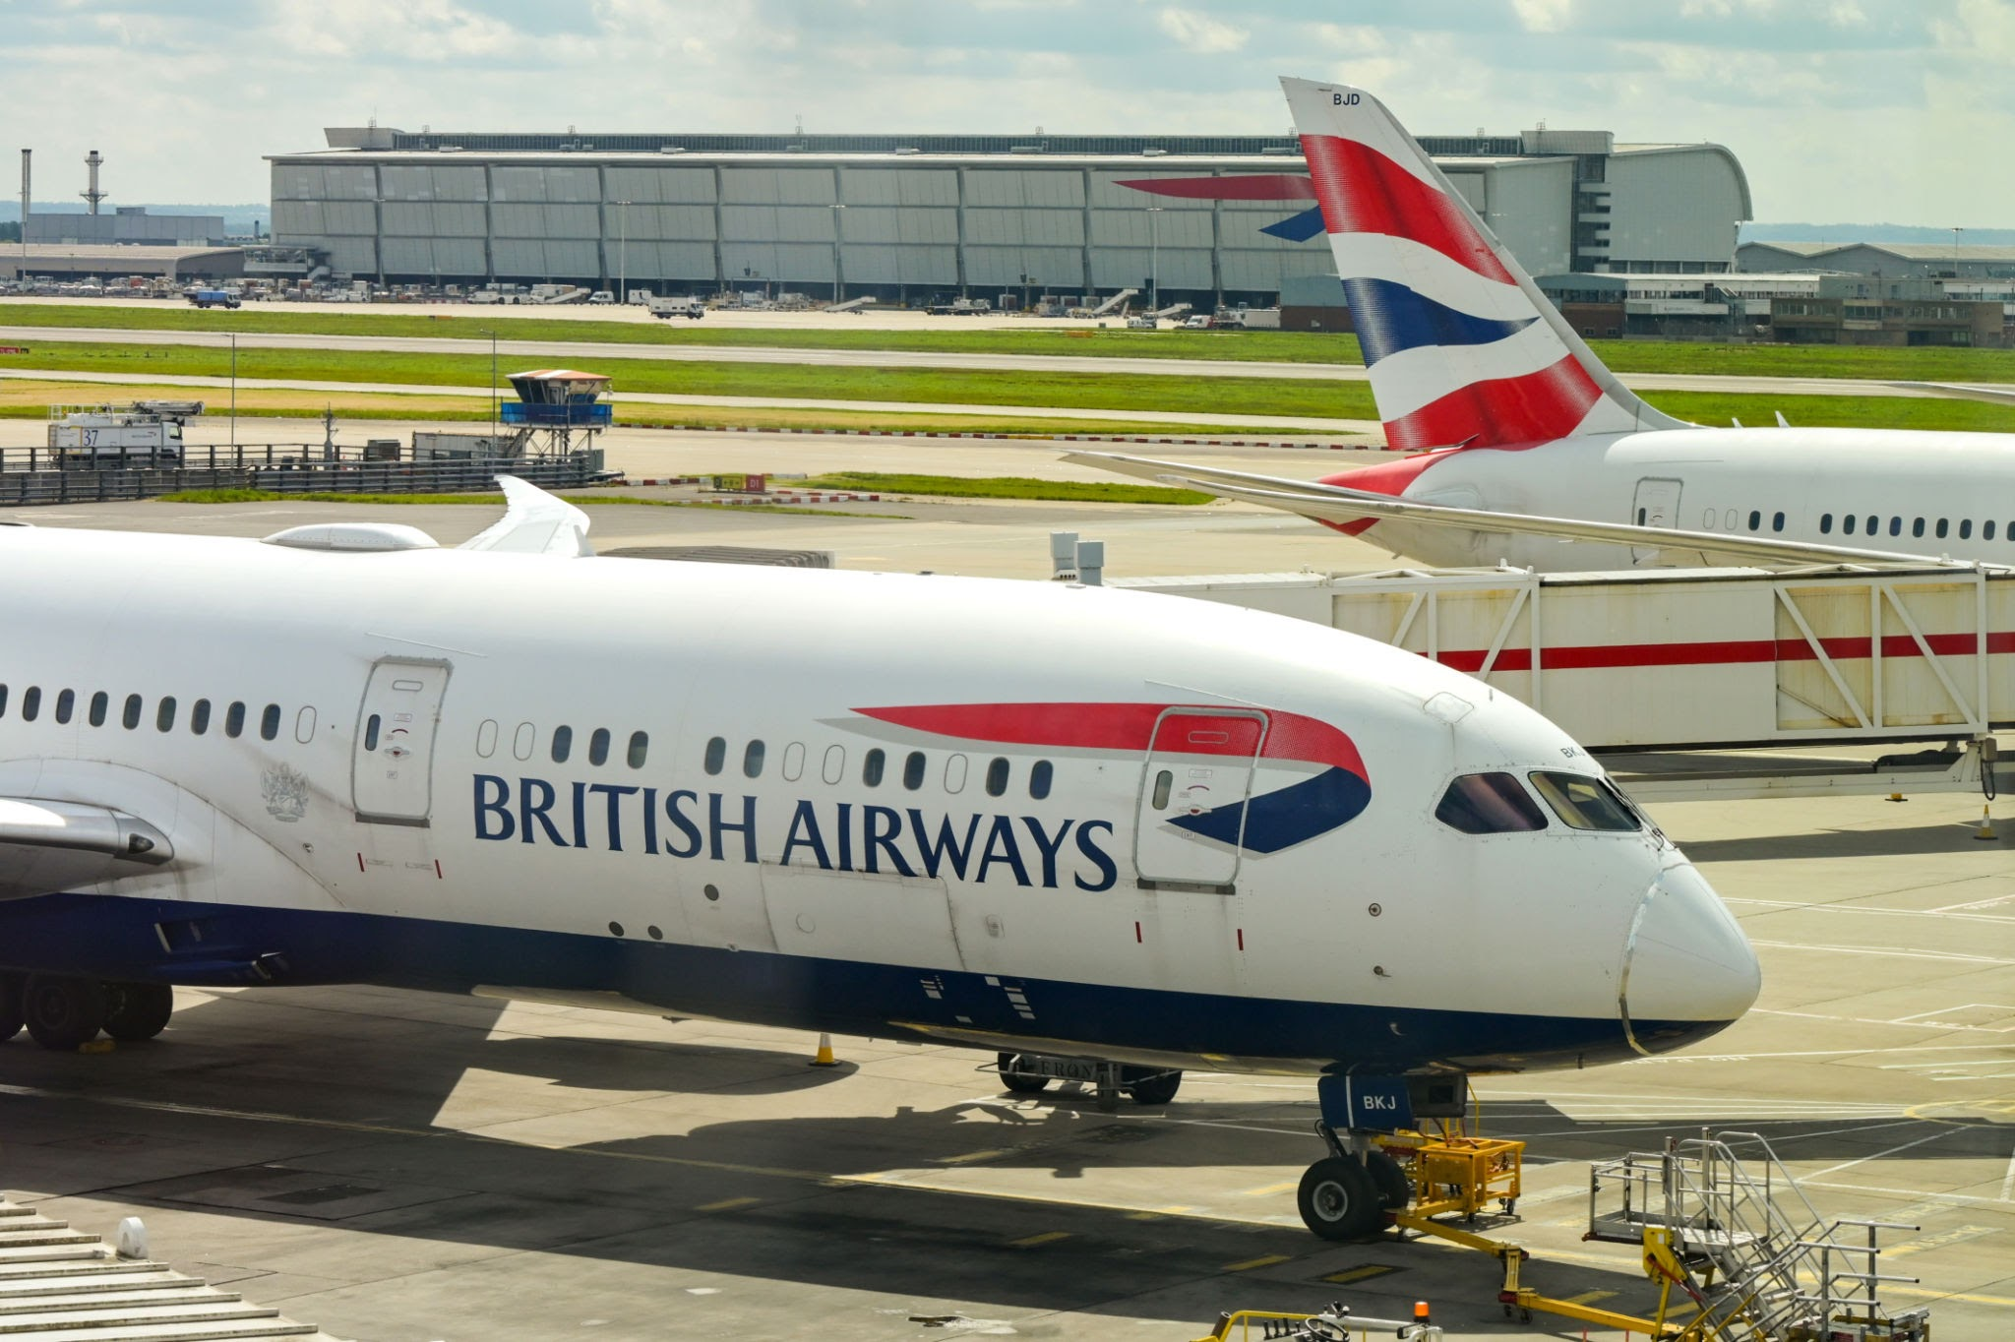
Predictive Modeling of Customer Booking Behavior
Submitted By: Mihir Shinde
Date: 22/07/2025

Slide 2
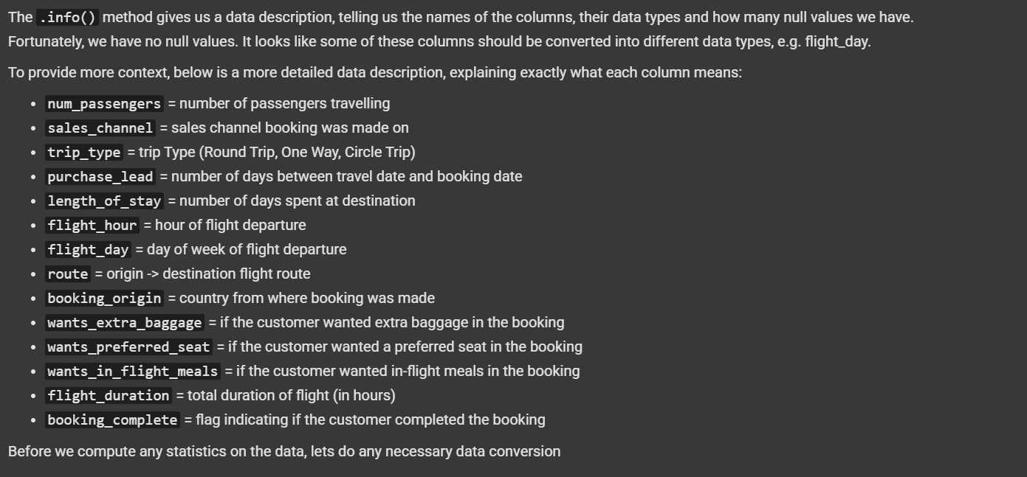

Slide 3

Data Summary:
- Dataset: ~50,000 rows of customer booking data
- Target Variable: booking_complete (0 = Not Booked, 1 = Booked)
- Feature Types:
- Numerical: purchase_lead, flight_hour, flight_duration, etc.
- Categorical: trip_type, sales_channel, route, booking_origin, etc.

Slide 4

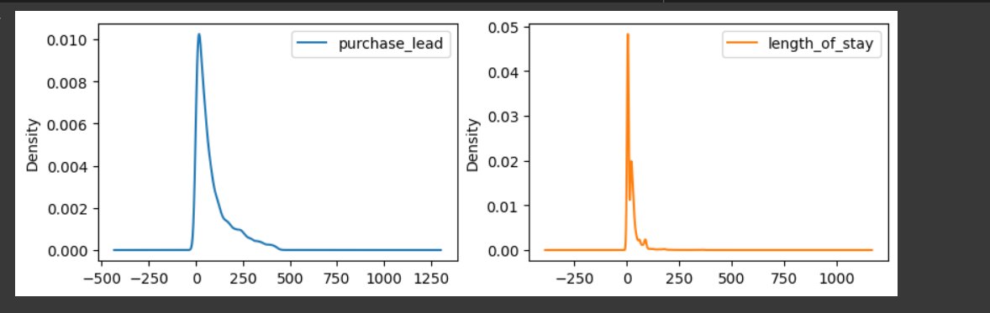
Feature Engineering & Preprocessing:
- Target encoding: route, booking_origin
- One-Hot Encoding: sales_channel, trip_type
- Mapped weekdays to numeric: flight_day
- SMOTE applied to balance target classes
- StandardScaler applied to numerical features

Slide 5
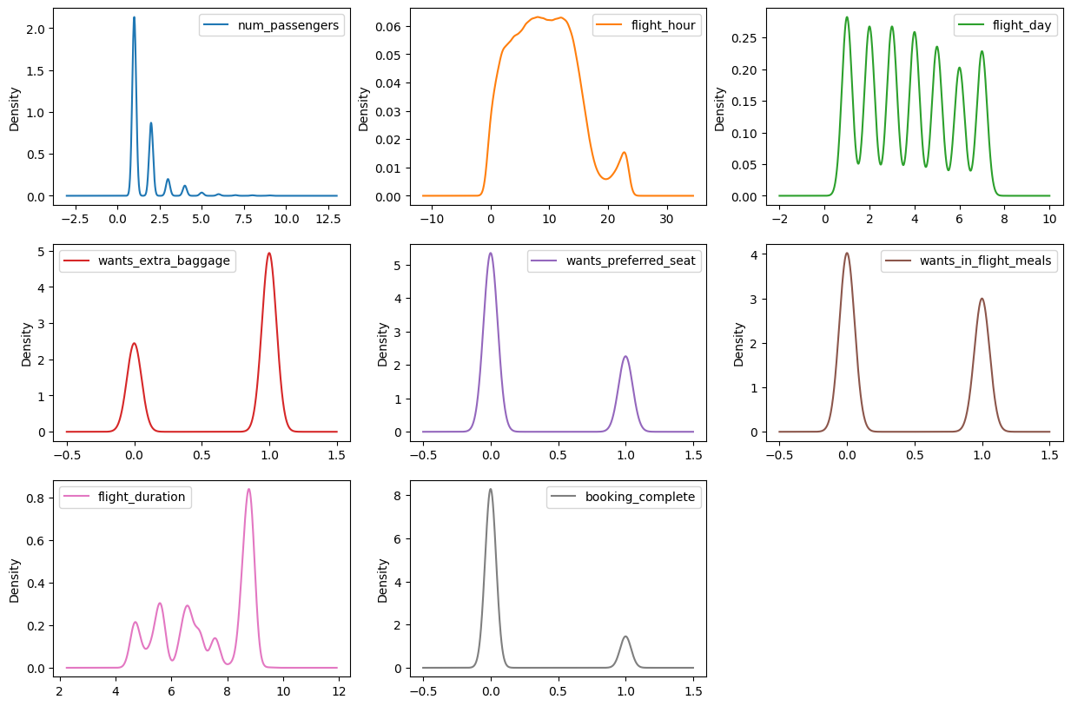

Slide 6
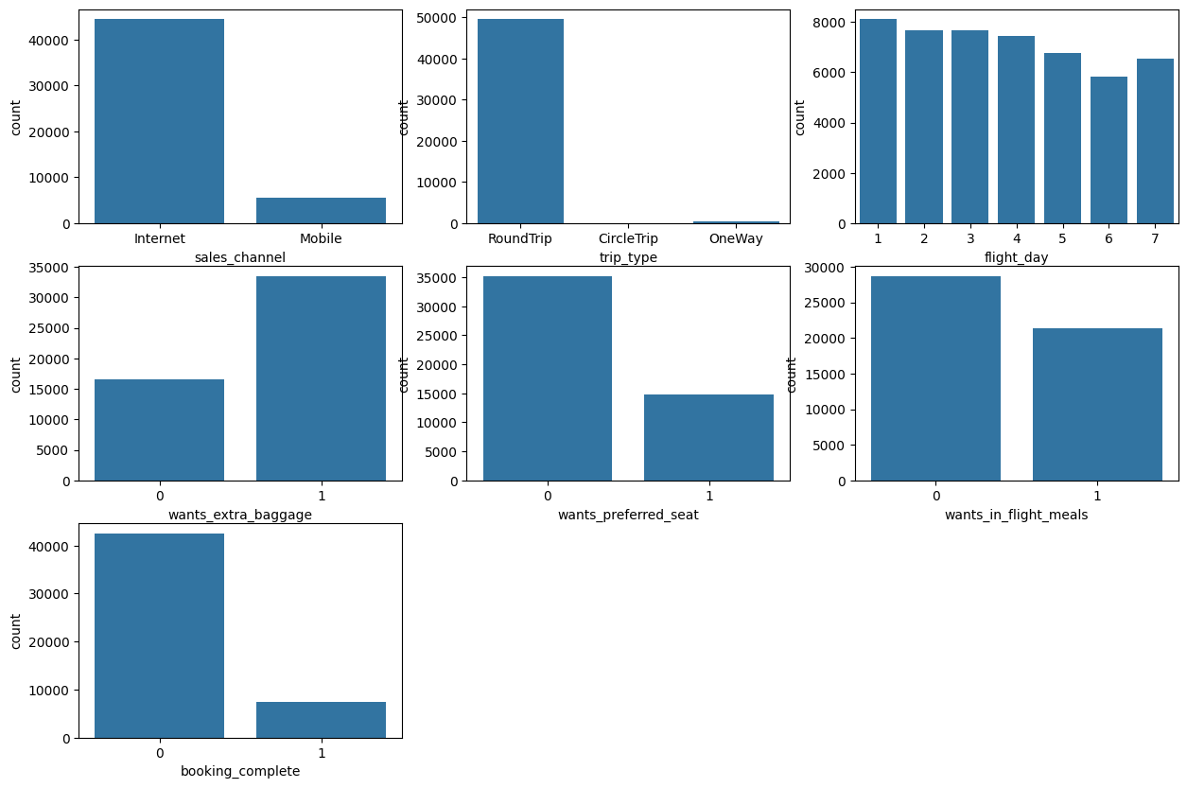

Slide 7
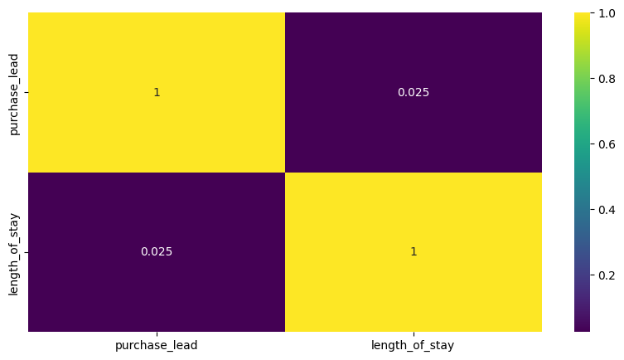

Slide 8

Models Used:
- Logistic Regression (with hyperparameter tuning)
- Random Forest Classifier (with class imbalance handling)

Slide 9
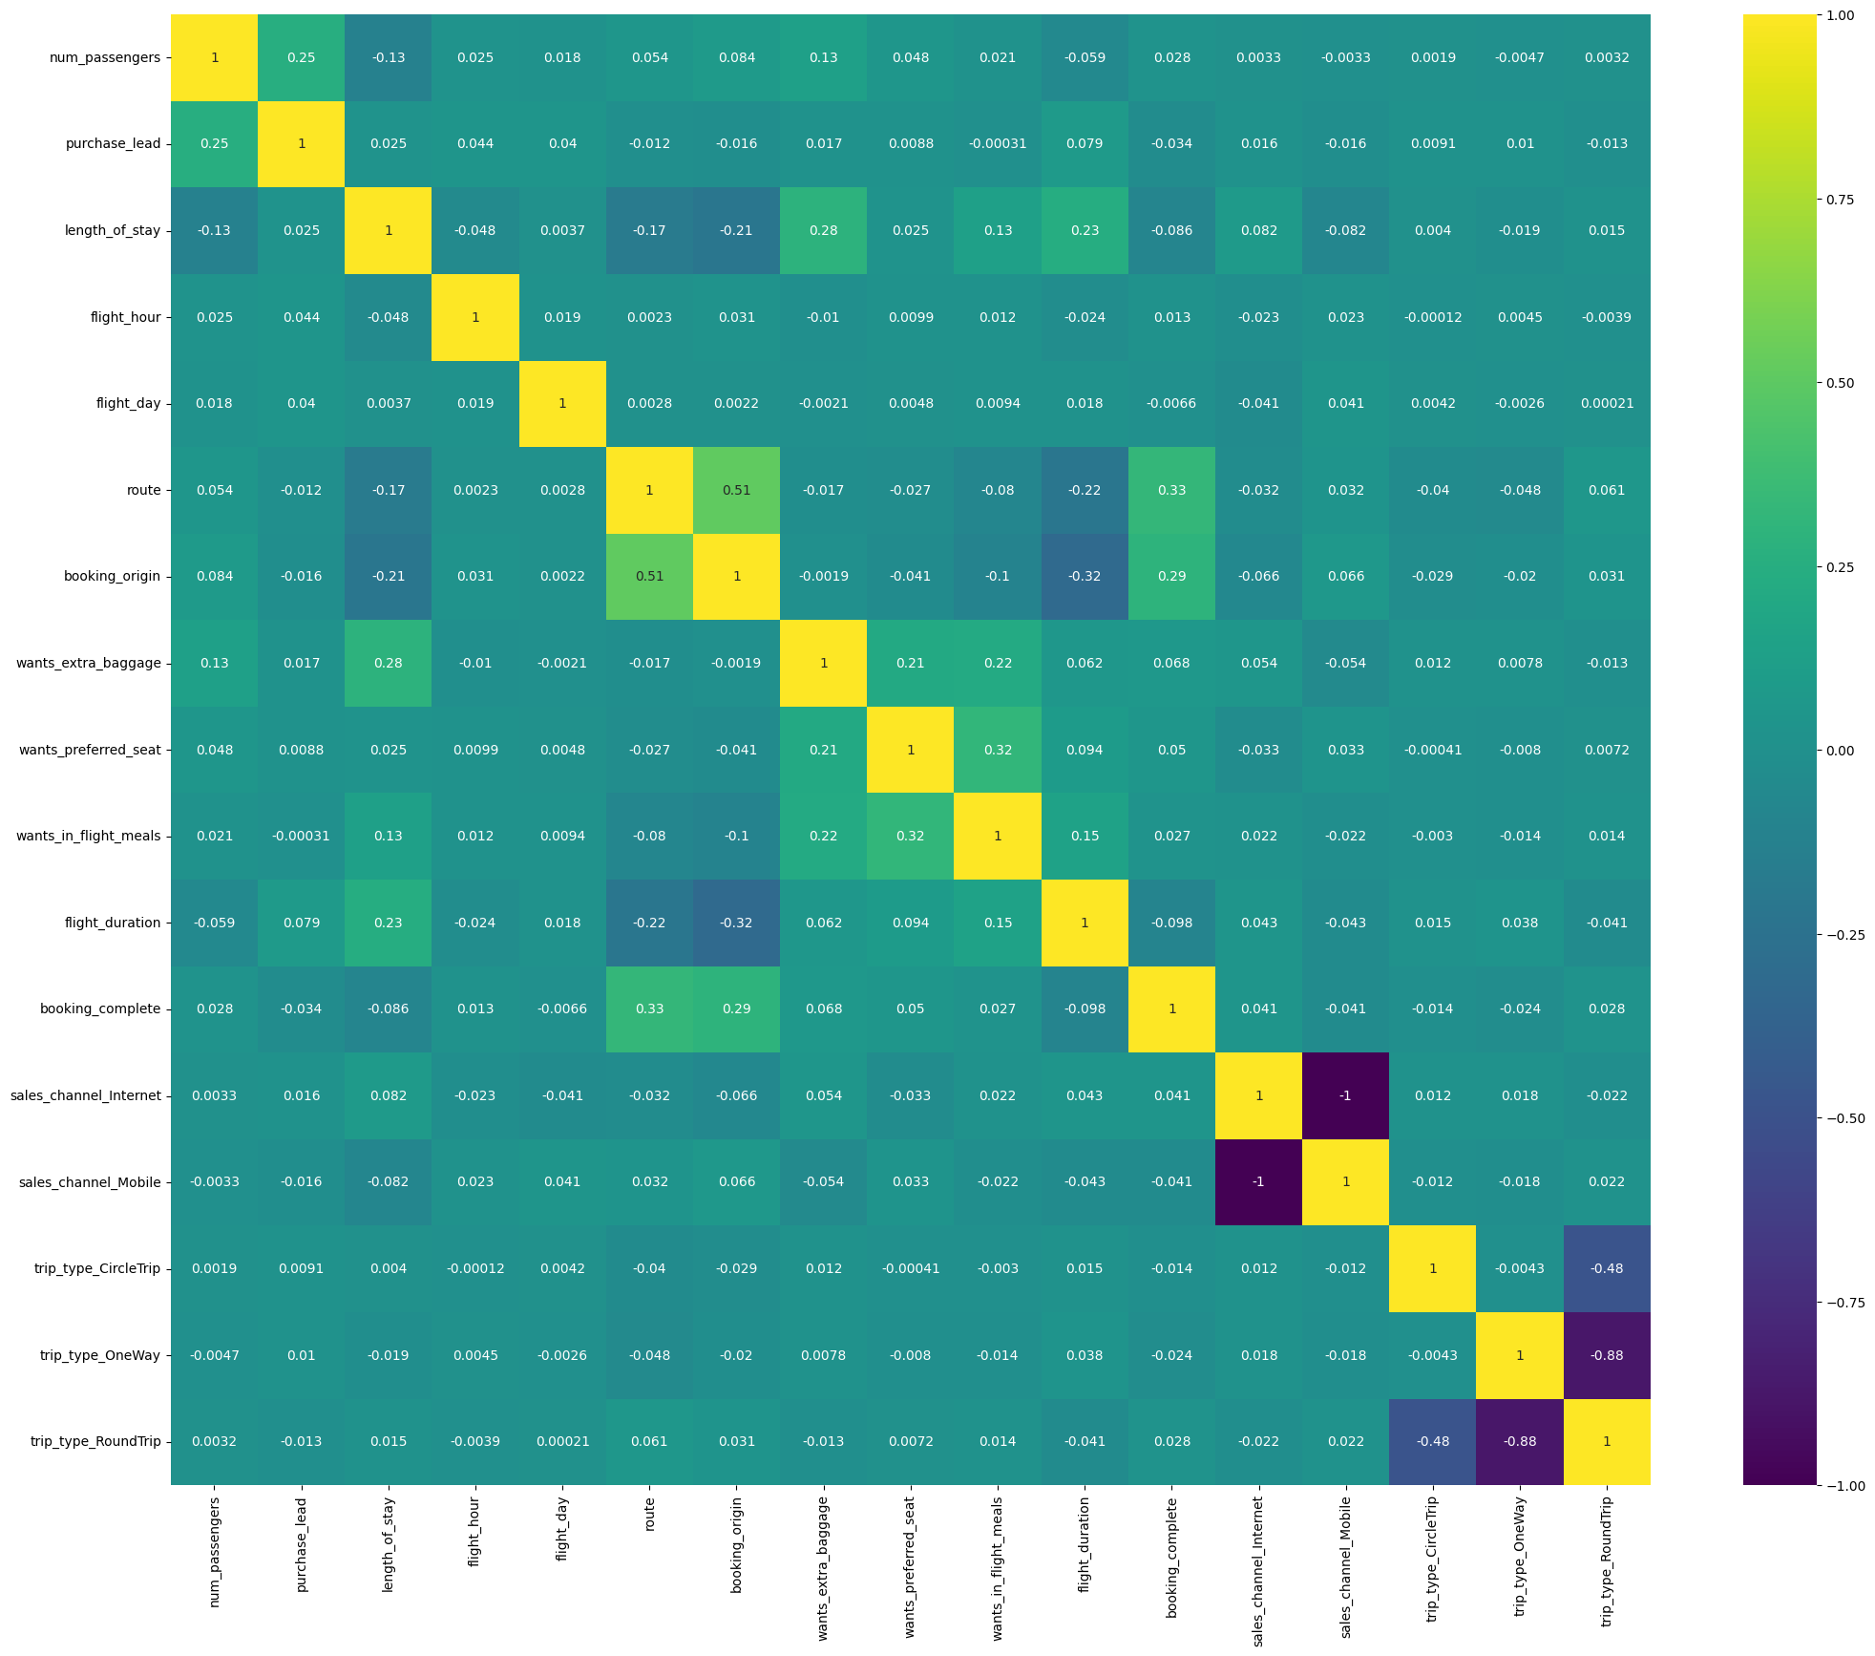

Slide 10
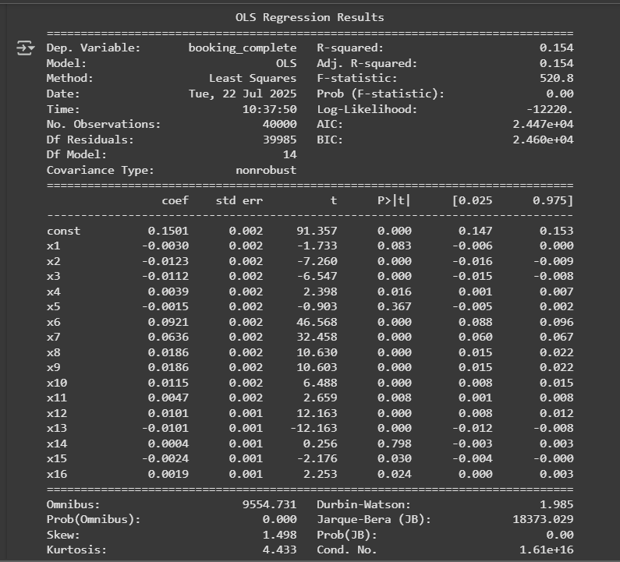

Slide 11
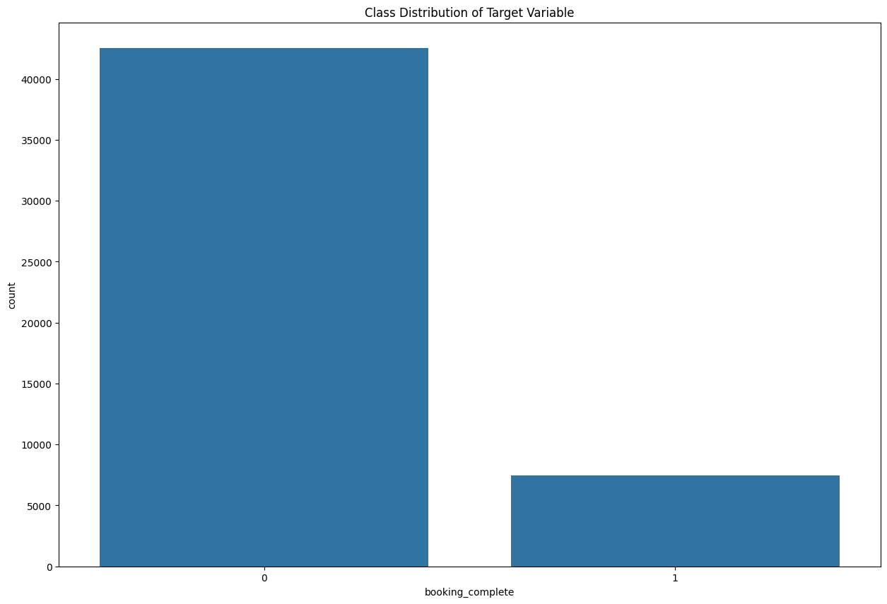

Slide 12
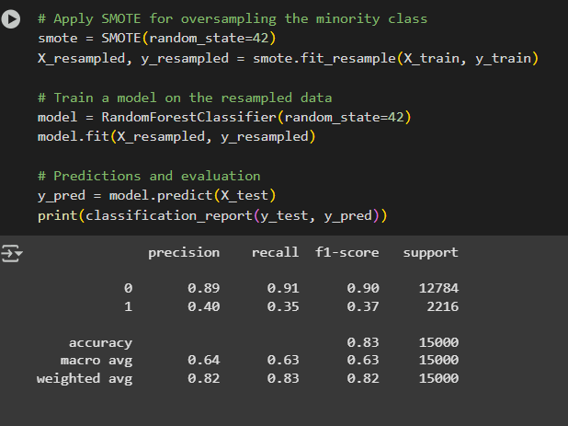
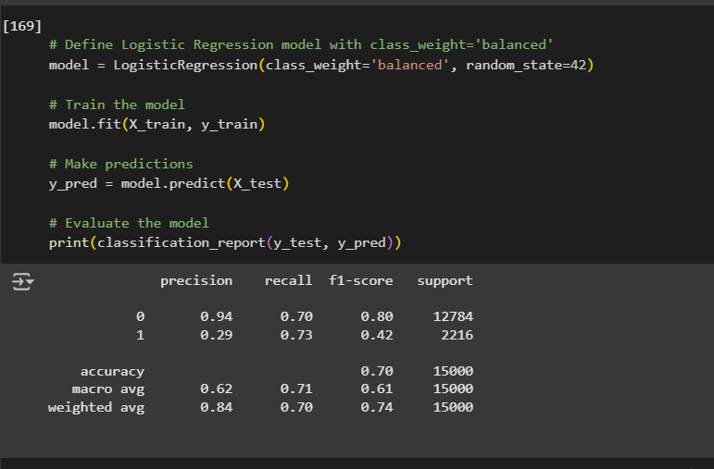

Slide 13
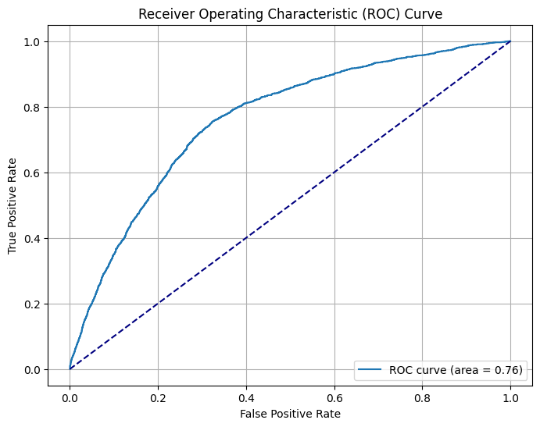

Slide 14
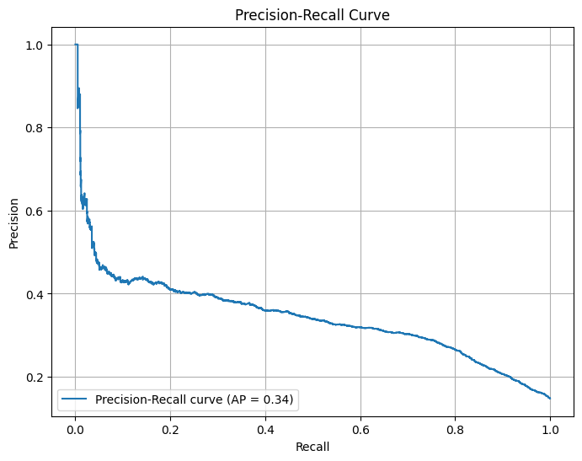

Slide 15
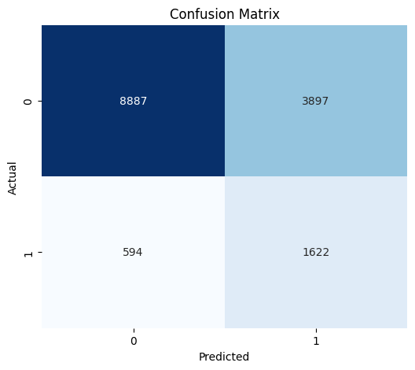
Model Evaluation (Best Performing: Logistic Regression):
- Accuracy: ~83%
- AUC Score: ~0.89
- F1-Score: 0.81

Slide 16
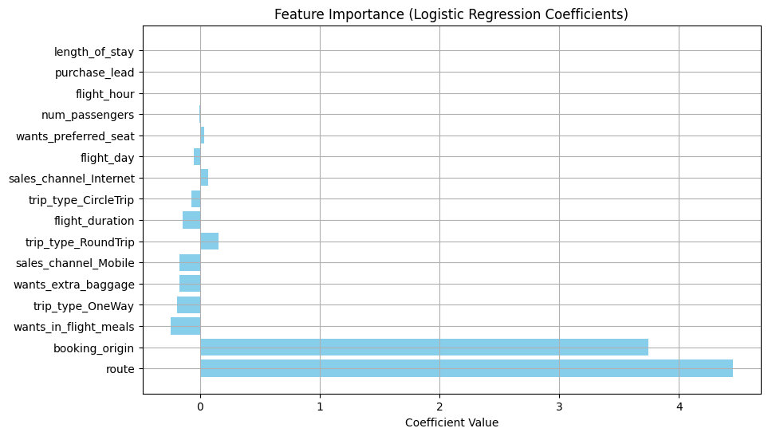

Slide 17



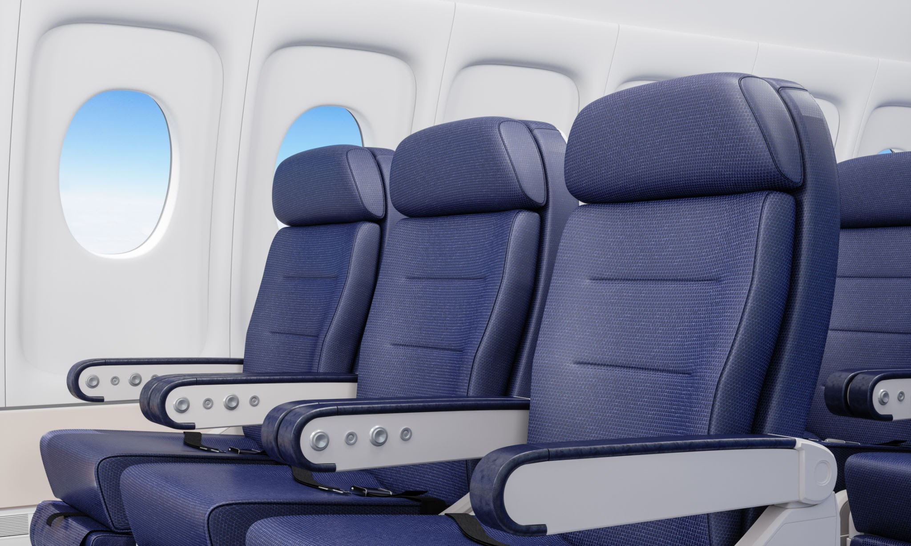
Top Predictive Features:
- Booking origin, Extra baggage, Trip type, Seat selection, Sales channel

Slide 18


Key Insights:
- Extra services indicate higher booking likelihood
- Country of origin and lead time matter
- Strong time feature influence

Slide 19
Important links:
https://scikit-learn.org/stable/supervised_learning.html
https://scikit-learn.org/stable/modules/model_evaluation.html
https://colab.research.google.com/drive/1Uw81UqMsf3Tj8bMHf4K_yvqDbcfR499L#scrollTo=O6XquAe4Byzl

Slide 20
CONCLUSION
BRITISH AIRWAYS
THANK YOU
Any questions?

